Slide 1




CARS : AUDI

Slide 2
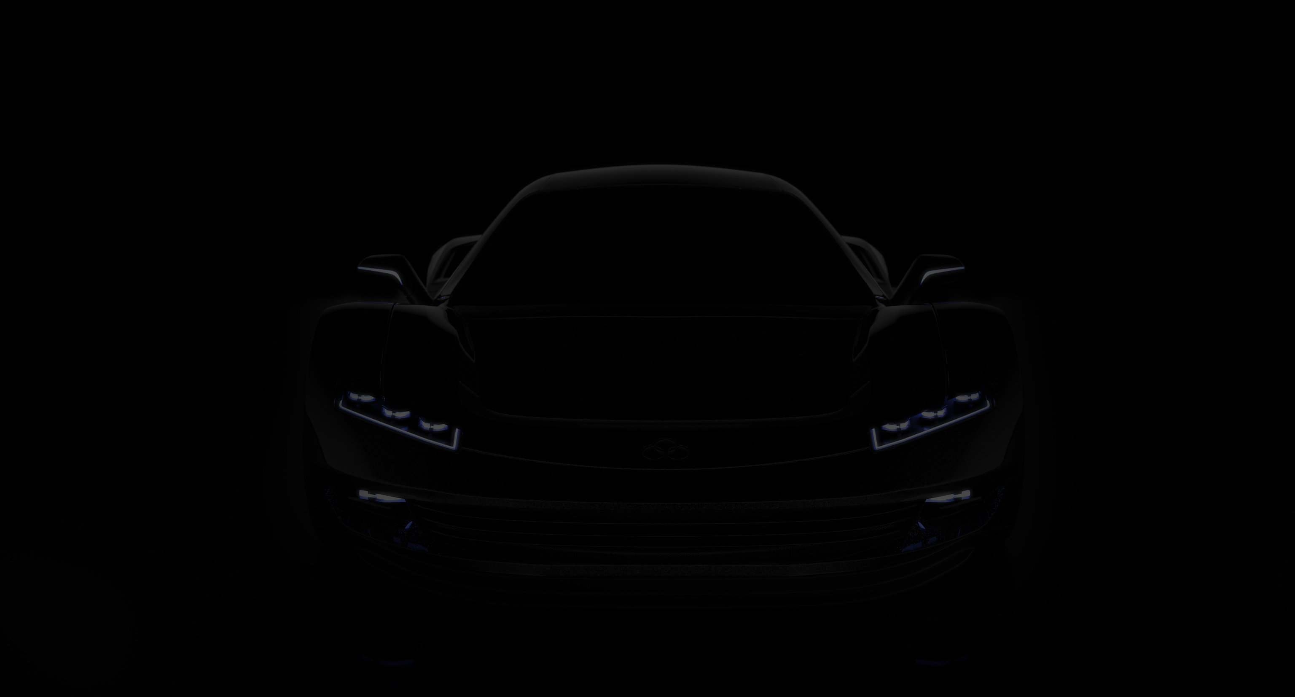

ABOUT
This project scrapes Audi car listings from Cars24 across multiple cities, extracting key details like year, kilometers driven, fuel type, transmission, price, location, and number of owners. The data is structured for analysis, providing insights into used car trends.”

Slide 3
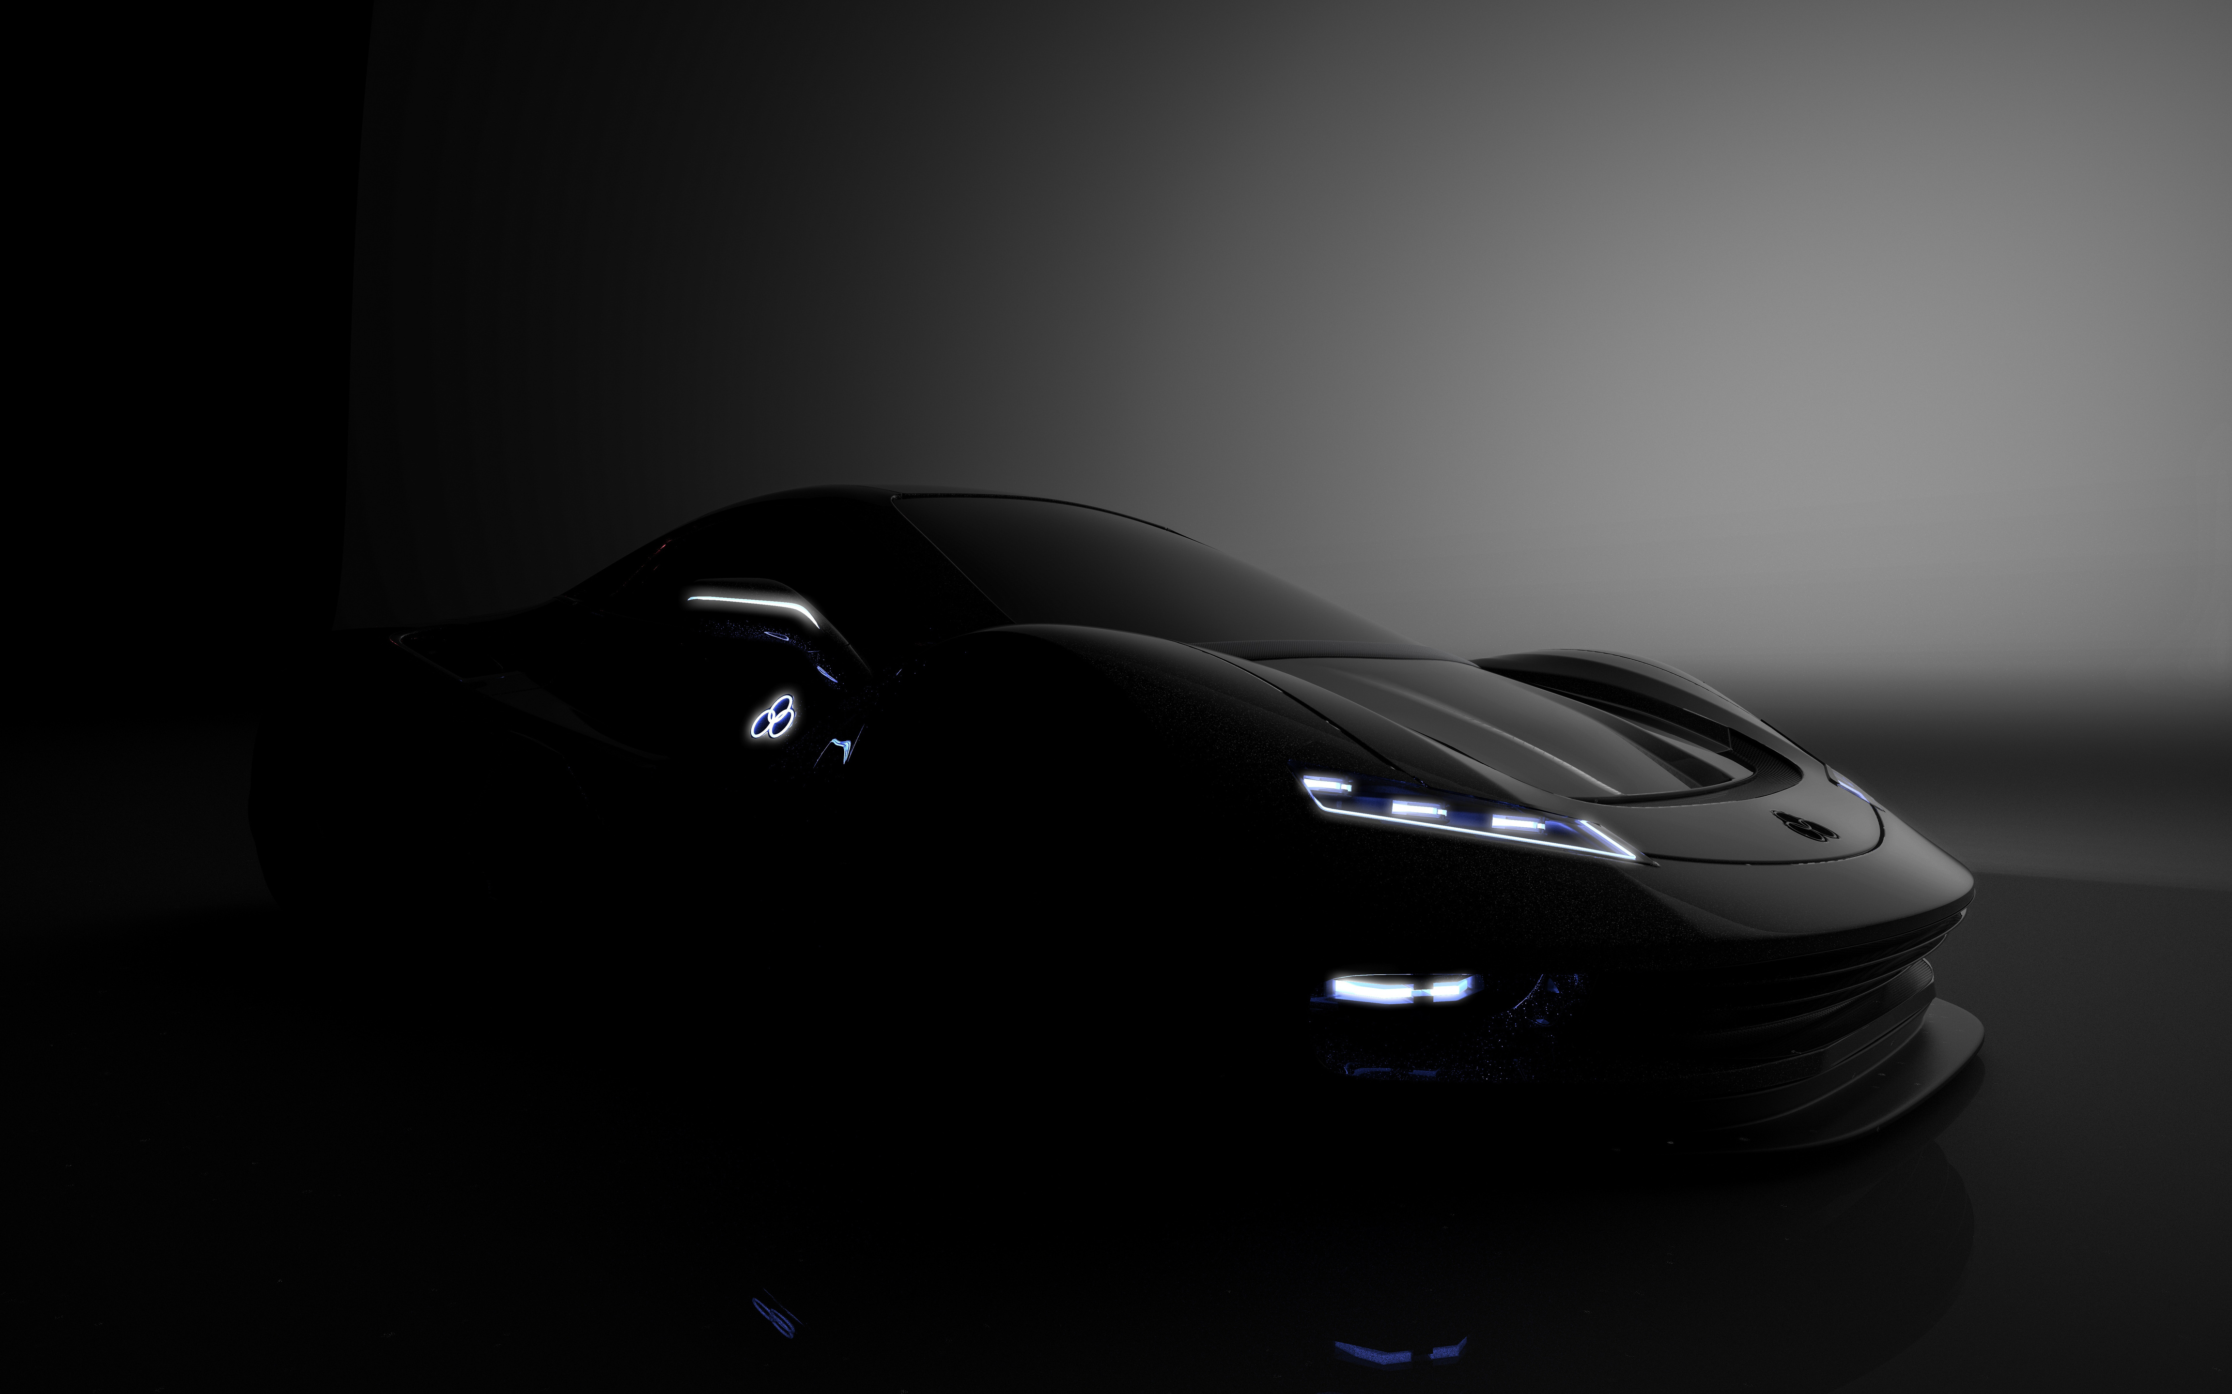
MISSION
WEB SCRAPPING
To build a reliable, automated system for gathering and analyzing used car data, providing insights that help buyers, sellers, and analysts understand trends in the used car market efficiently.”
To extract accurate Audi car details from Cars24, clean and organize the data, and enable meaningful analysis of prices, mileage, fuel types, transmission, locations, and ownership patterns.”

Slide 4

VEHICLE SELECETION
“We focus on Audi cars listed on Cars24 in three major cities: Mumbai, Chennai, and Bangalore. Only relevant details such as year of manufacture, kilometers driven, fuel type, transmission, price, location, and number of owners are extracted to ensure meaningful analysis

Slide 5

TOOLS :
Programming Language : Python
Libraries & Frameworks:
Selenium – Automates browser scrolling and dynamic content loading
BeautifulSoup – Parses and extracts HTML data
Requests – Fetches detail pages for owners info
Pandas – Cleans, structures, and saves data
Additional Tools:
ChromeDriver,
Jupyter Notebook
VSCode

Slide 6
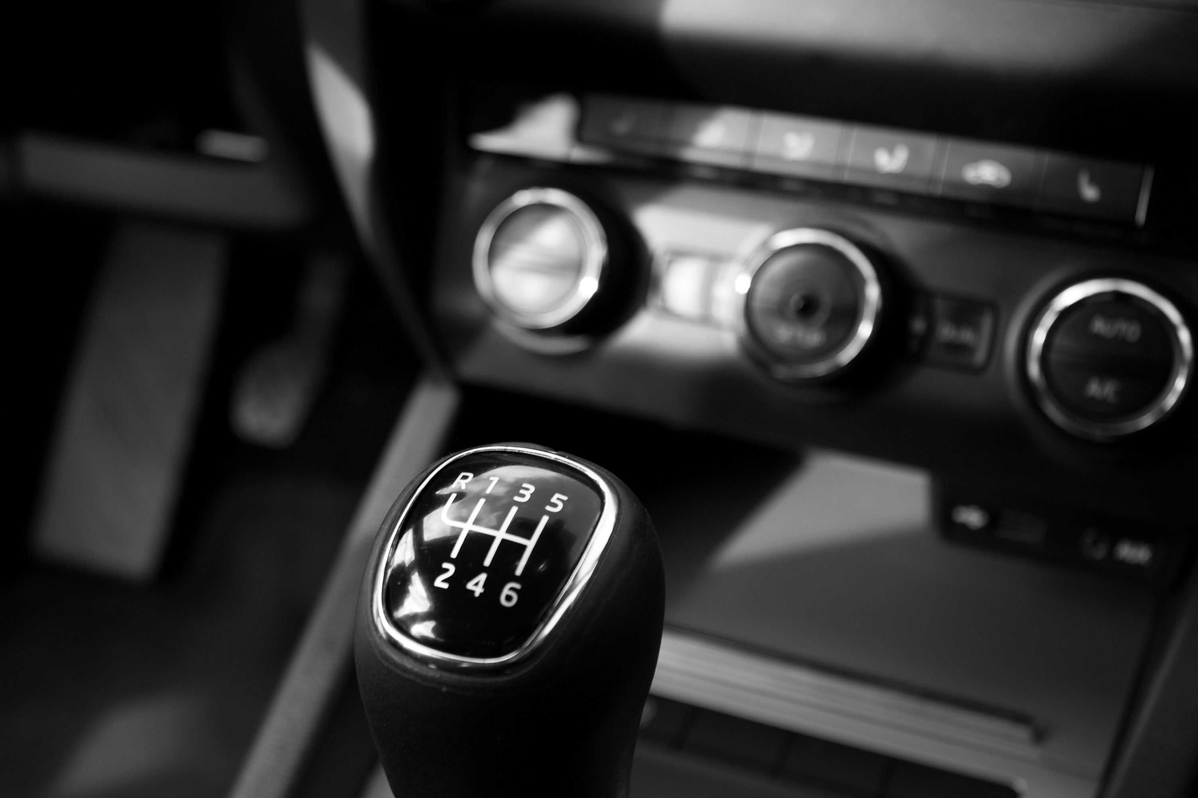
PROCESS
Target Selection: Audi car listings from Cars24 for Mumbai, Chennai, and Bangalore.
Dynamic Loading: Use Selenium to scroll and load all car listings.
Data Extraction: Parse HTML with BeautifulSoup to get year, km, fuel type, transmission, price, location, and registration.
Detail Page Scraping: Visit individual car pages to extract the number of owners.
Data Cleaning & Structuring: Remove unwanted symbols, handle missing values, and organize data into tables.
Output: Save the structured data in CSV/Excel for analysis.

Slide 7

TEAM MEMBERS
Umasankar G
Vaishnavi Sanjay Patil
Umasankar
Vaishnavi
Vaibhav Kulkarni
Vijay Seetharam Illindra
Veeramalla Srikanth
Vaishnavi Nagane
Vaibhav Upreti
Umesh Rathod

Slide 8

BORCELLE CAR DEALER
THANK YOU
EMAIL
PHONE
umashankargudivada@gmail.com
+916303482997
GITHUB
https://github.com/UmasankarIT

